Slide 1
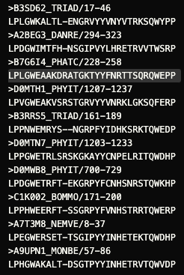
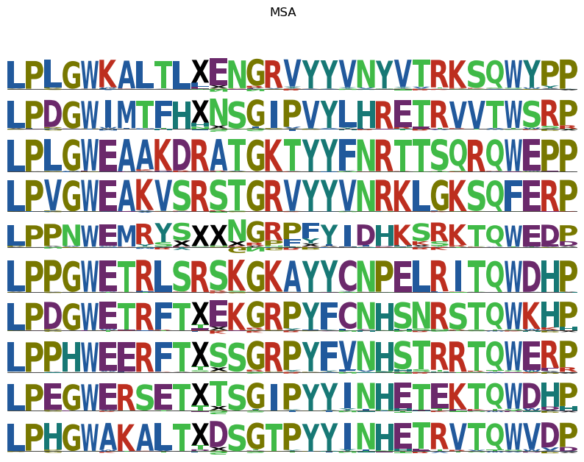
21 CHANNELS, BATCH_SIZE=10, LENGTHSCALE = 0.5, ITERS = 500

Slide 2
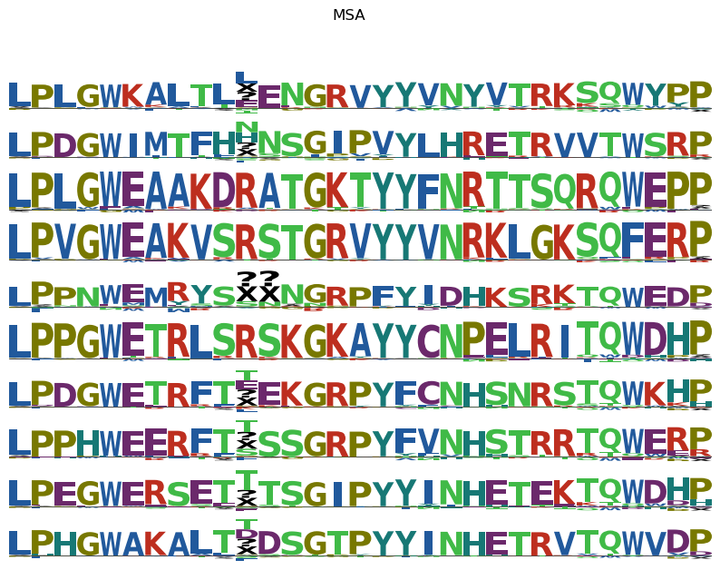
22 CHANNELS, BATCH_SIZE=4, LENGTHSCALE = 0.65, ITER = 140,

Slide 3
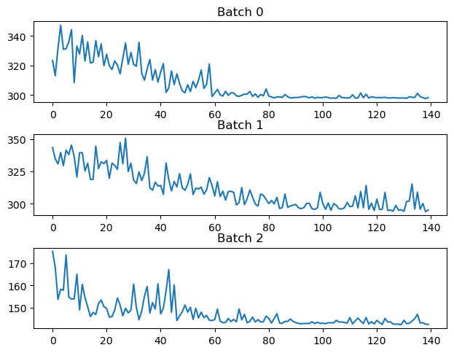
22 CHANNELS, BATCH_SIZE=5, LENGTHSCALE = 0.5, ITER = 160,

Slide 4
EXPERIMENTS DIFFERENT PADDING STRATEGIES 2 FEB 2023 – Seed Samples

Slide 5
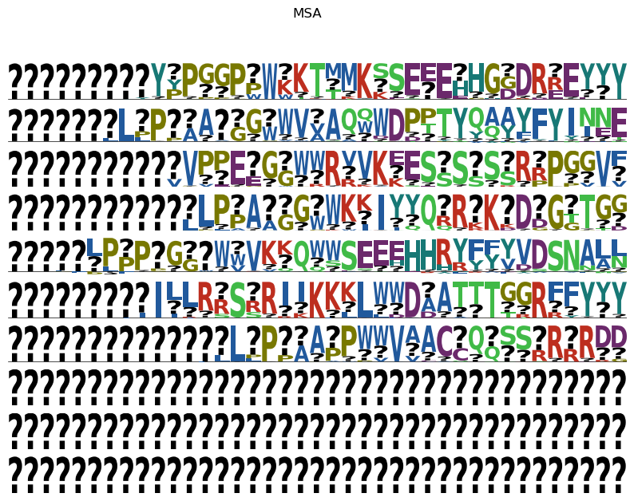
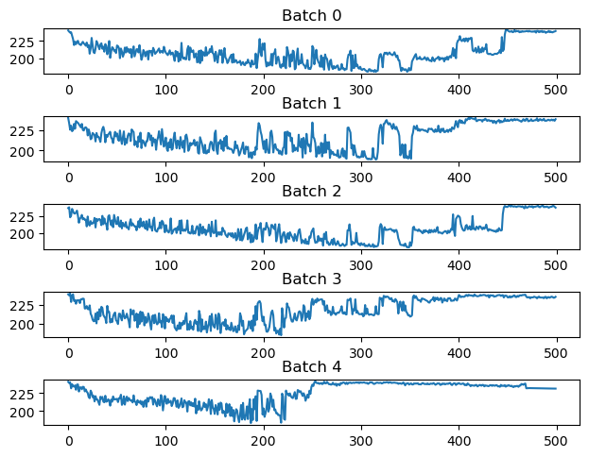
PADDING BOTH CORNERS, EPOCHS=500, LENGTHSCALE =0.5, LR = 1E-4, DIM Z= 60

Slide 6
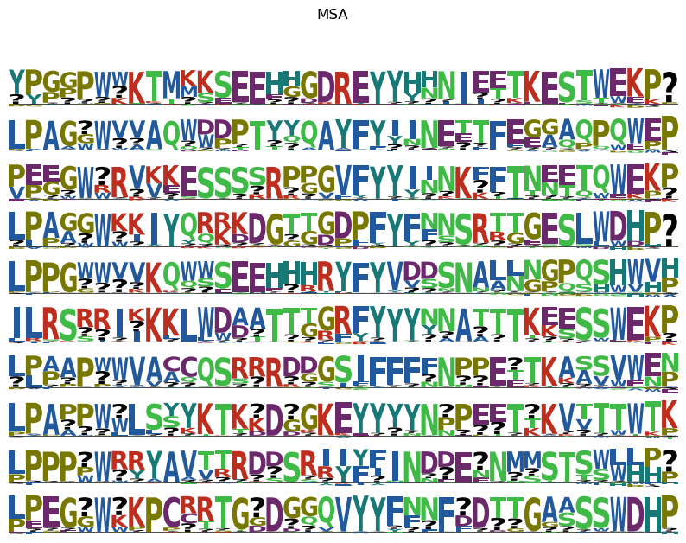
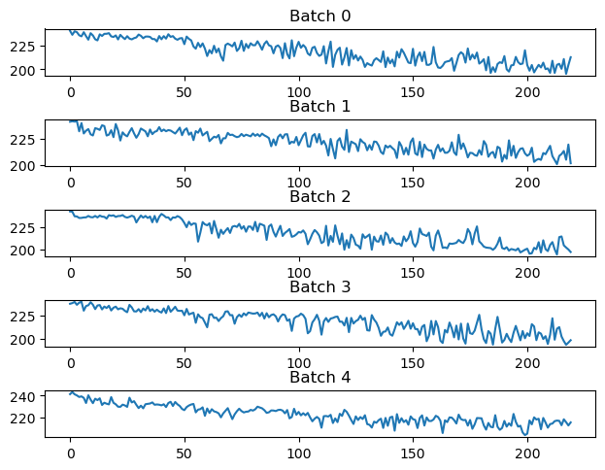
PADDING BOTH CORNERS, EPOCHS=220, LENGTHSCALE =0.5, LR = 1E-4, DIM Z= 60

Slide 7
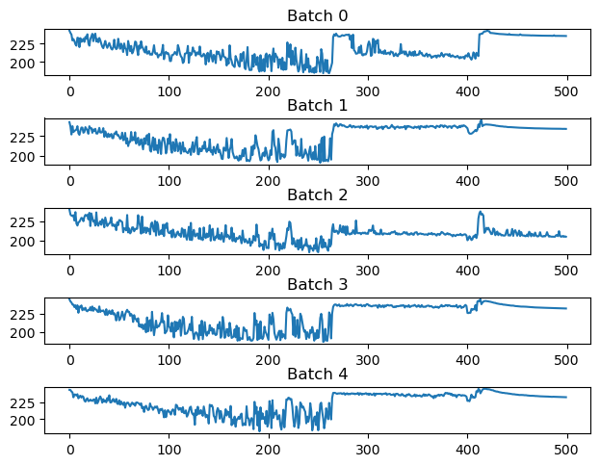
RANDOM PADDING, EPOCHS=500, LENGTHSCALE =0.5, LR = 1E-4, DIM Z= 60

